Slide 1




Like us on Facebook and follow us on Twitter and Instagram
PINOLE POLICE DEPARTMENT
Council Update
Tuesday, February 20, 2024

Slide 2



Pinole Police Department

Slide 3

Staffing
As of January 2023
Allocated sworn numbers: 30
Current sworn numbers: 27 *
Allocated civilian numbers: 19.25
Current civilian staffing: 19.25
Recruitment updates on the positions in the process:
* Two (2) Police Officer Trainees in police academy – Graduation May 2023
Open recruitment for Lateral Officer
Newly hired Community Service Officer
Opening recruitment (internal/external) for Police Sergeant in March

Slide 4
Crime Reporting: UCR vs NIBRS
UCR: Created in 1929 by FBI for nationwide measure of crime rates
Designed as a summary reporting system (SRS) to serve as a barometer of crime on a state and national scale
Modified to the National Incident Based Reporting System (NIBRS) in 1989 to capture ALL offenses in an incident
In January 2021, NIBRS became the FBI’s national standard. NIBRS is now the only method for reporting to the FBI’s UCR Program

Slide 5
Crime Reporting: UCR vs NIBRS
UCR Part I
Murder
Forcible Rape
Robbery
Aggravated assault
Burglary
Motor vehicle theft
Larceny
Arson
VS
NIBRS Group A
Homicide
Sex Offenses-forcible
Robbery
Assault offenses
Burglary
Larceny/Theft Offenses
Motor Vehicle Theft
Arson
Fraud
Bribery
Gambling
Extortion/Blackmail
Prostitution Offenses
Kidnapping/Abduction
Counterfeiting/Forgery
Drug/Narcotic Offenses
Weapon Law Violations
Sex Offenses-nonforcible
Stolen Property Offenses
Pornography/Obscene Material
Vandalism/Destruction of Property

Slide 6
Crime Reporting: UCR vs NIBRS
NIBRS Categories:
Crimes Against Persons: assault, homicide, human trafficking, kidnapping, sex offenses
Crimes Against Property: bribery, burglary, counterfeit/forgery, vandalism, embezzlement, extortion/blackmail, fraud, larceny/theft, motor vehicle theft, robbery, stolen property, bad checks
Crimes Against Society: drug/narcotics, gambling, pornography/obscene material, prostitution, weapons laws, loitering, disorderly conduct, driving under the influence, drunkenness
** NIBRS moved robbery from persons crime to property crime

Slide 7
UCR Part 1 & NIBRS Group A Crimes
UCR | 2020 (UCR) | 2021 (UCR) |  | 2022 (UCR) *
Homicide | 1 | 1 | N/A | 0
Rape | 1 | 1 | N/A | 2
Robbery | 23 | 28 | 22% | 5
Assault | 65 | 85 | 31% | 23
Burglary | 53 | 59 | 11% | 11
Larceny | 273 | 480 | 76% | 113
Stolen Vehicle | 61 | 60 | -2% | 11
Arson | 2 | 3 | 50% | 2
Crimes Against Persons | 90 | 115 | 32% | 30
Crimes Against Property | 389 | 602 | 54% | 137
* Jan-Mar 2022

Slide 8
UCR Part 1 & NIBRS Group A Crimes
NIBRS | 2022 (NIBRS)* | 2022 Annualized (NIBRS)** | 2023 (NIBRS) | Annualized **
NIBRS Group A | 779 | 1037 | 930 | -11%
Crimes Against Persons | 133 | 177 | 158 | -11%
Crimes Against Property | 584 | 778 | 632 | -19%
Crimes Against Society | 62 | 82 | 140 | 70%
* April - Dec 2022
** Approximate based on annualization of 9 months of 2022 data

Slide 9

2022 * & 2023 NIBRS Crimes
 |  | 2022* | 2023 |  |  |  | 2022* | 2023
Murder |  | 1 | 0 |  | Extortion/Blackmail |  | 0 | 0
Negligent Manslaughter |  | 1 | 0 |  | Fraud |  | 39 | 49
Justifiable Homicide |  | 0 | 0 |  | Gambling |  | 0 | 0
Rape |  | 6 | 2 |  | Kidnapping |  | 9 | 9
Robbery |  | 14 | 23 |  | Pornography |  | 0 | 1
Aggravated Assault |  | 31 | 39 |  | Prostitution |  | 0 | 1
Burglary |  | 40 | 49 |  | Sodomy |  | 1 | 0
Larceny |  | 313 | 316 |  | Sexual Assault w/Object |  | 0 | 1
Motor Vehicle Theft |  | 58 | 67 |  | Fondling |  | 3 | 8
Arson |  | 5 | 2 |  | Incest |  | 0 | 0
Simple Assault |  | 70 | 84 |  | Statutory Rape |  | 2 | 1
Intimidation |  | 9 | 11 |  | Stolen Property |  | 22 | 24
Bribery |  | 0 | 0 |  | Weapons Law Violations |  | 17 | 32
Counterfeiting/Forgery |  | 5 | 6 |  | Human Trafficking, Commercial Sex Acts |  | 0 | 0
Vandalism |  | 84 | 92 |  | Human Trafficking, Involuntary Servitude |  | 0 | 3
Drug/Narcotic Violations |  | 31 | 63 |  | Animal Cruelty |  | 0 | 1
Drug Equipment Violations |  | 14 | 42
Embezzlement |  | 4 | 4 |  | Total Group A |  | 779 | 930

Slide 10

Response Times
Annual Average Response Times for Priority 1 Calls
2023 2:49
2022 3:15
2021 3:24
2020 3:55
2019 3:47
2018 3:38
* Under 5:00

Slide 11

911 Answer Times
Annual Average Dispatch Answer Times
911 Calls ≤ 10 Secs ≤ 20 Secs
2023 18,525 97.71% 99.84%
2022 19,753 96.4% 99.86%
2021 19,352 97.01% 99.88%
* State Requirement 90% 95%

Slide 12
The Blotter & Citizen RIMS
The Blotter:
  Summarizes highlighted incidents
  Does not include details about every crime reported
  Does not include officer-initiated activity (traffic stops, pedestrian stops, etc) where no case is taken
  Does not include missing persons, mental health calls, sex registrants, loose dogs, welfare checks, and medical calls
  Information is manually pulled from multiple databases and is labor-intensive

Slide 13
The Blotter & Citizen RIMS
Citizen RIMS:
  Increase access to law enforcement information and services
  Reduce staff time by automating the dissemination of information
  Web-based format
  Vacation Home Check & Security Camera Registration
  Sign up for alerts
  Will include
    Map displaying calls-for service/incidents
    Missing Persons
    Stolen Vehicles
    Arrest Log

Slide 14
The Blotter & Citizen RIMS
Transition from The Blotter to Citizen RIMS
  Will take place over next 30-45 days
  Public information campaign to educate the public on Citizen RIMS and how to access
    Pushed out on PD and City social media platforms and communications

Slide 15
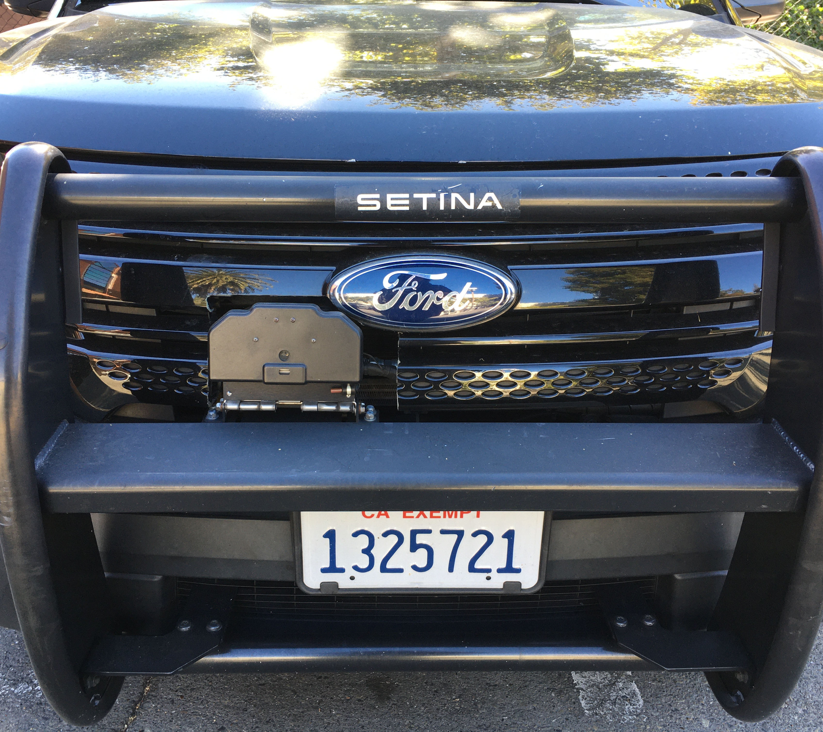
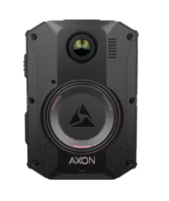
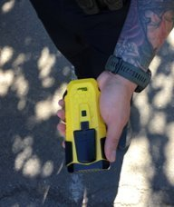
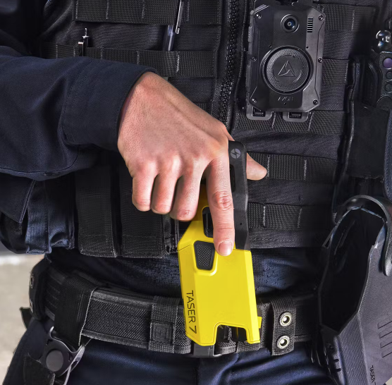
Technology to Assist with Initiatives
BOLA Wrap restraint device
StarChase pursuit alternative
AXON Body 3 Cameras
TASER Device

Slide 16
2023-24 Goals
#1 Goal-Fully Staffed
Reduction of crime and continued implementation of 21st Century Policing concepts
Continue to develop and implement pioneering outreach opportunities to engage our community
Innovation-continue to seek out technology, training, and organizational wellness opportunities to enhance our officers and our relationship with the community
Finalize the City’s Emergency Operations Plan (EOP) update
Implement the modified 4/10 patrol schedule (July FY2024/25) and CERT Program *

Slide 17

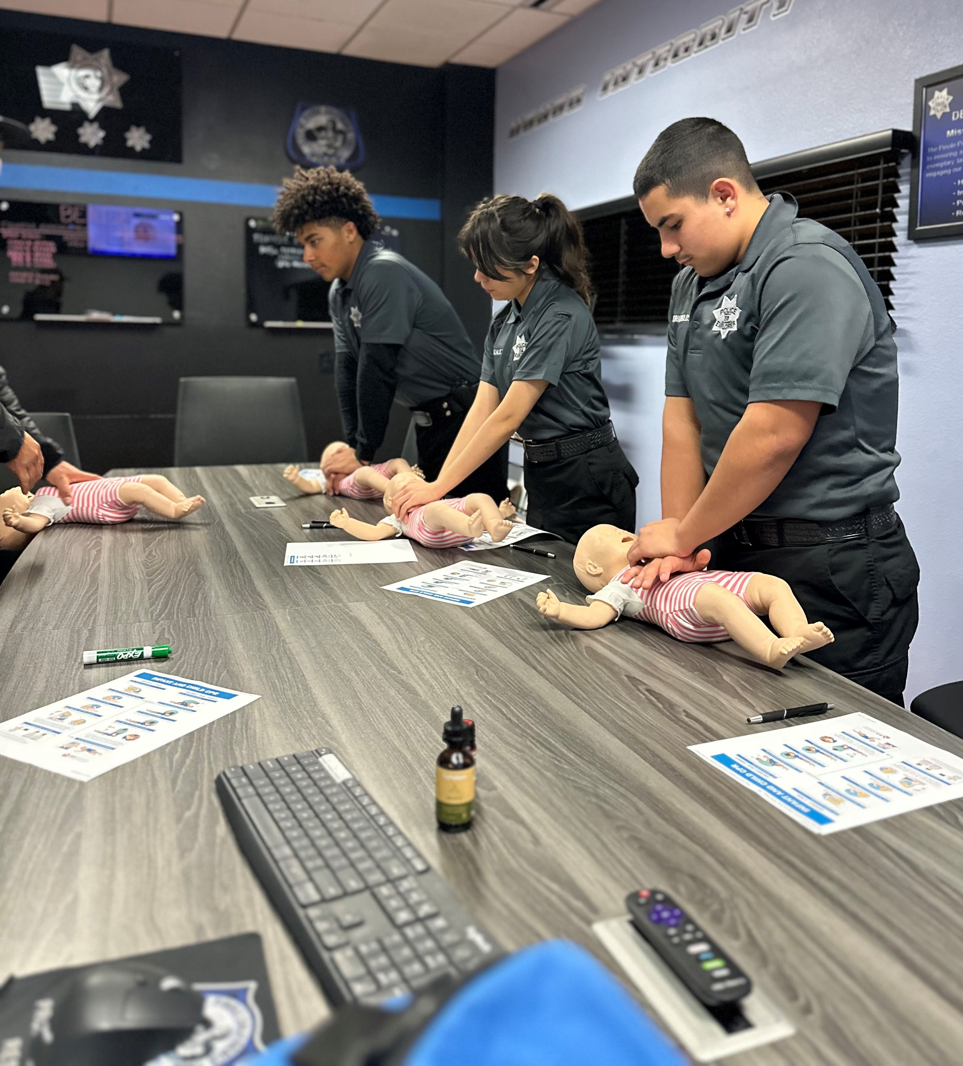
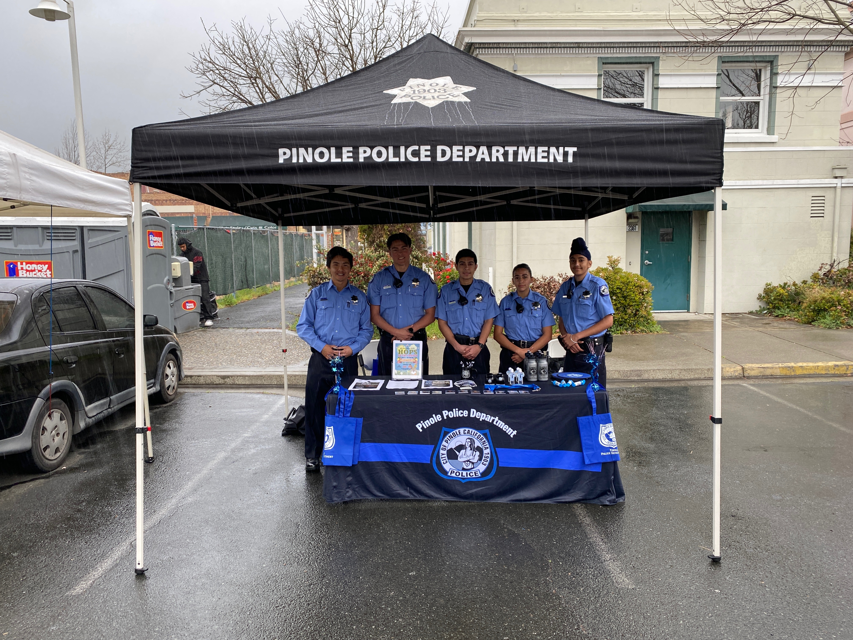
Volunteers
Police Explorer Program
Created Pinole Posse in 2018
    Volunteer Patrols-Deployed out into our community “hotspots” as determined by data gathered from RIMS and community concerns.

Slide 18


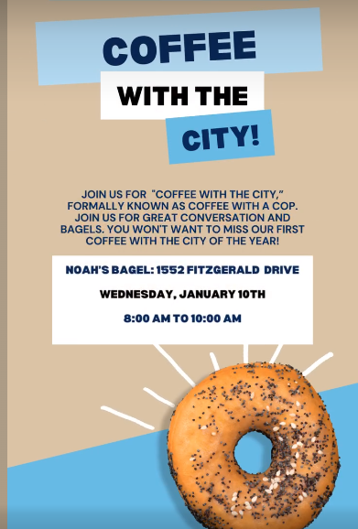



Community Outreach

Slide 19
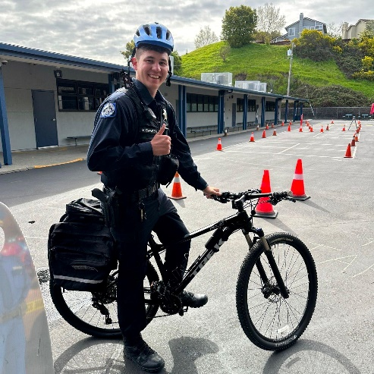
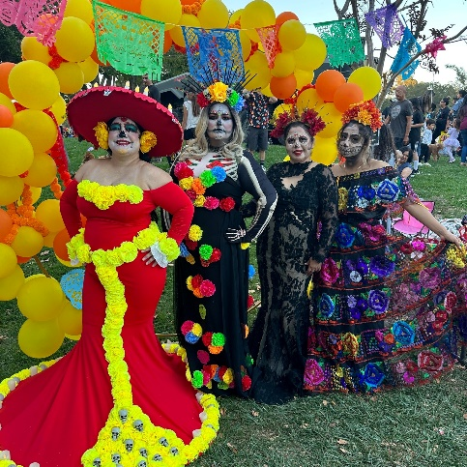
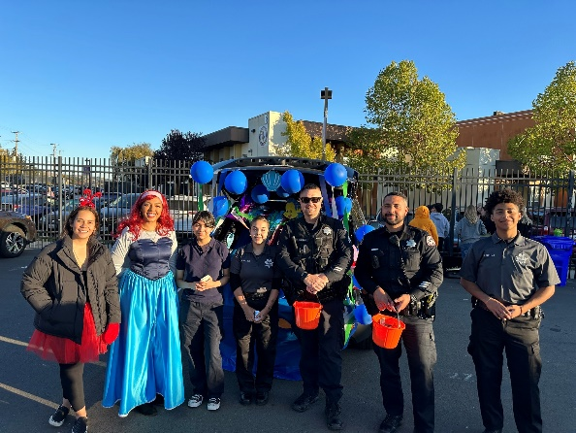
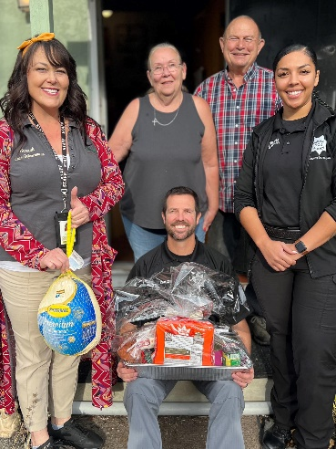
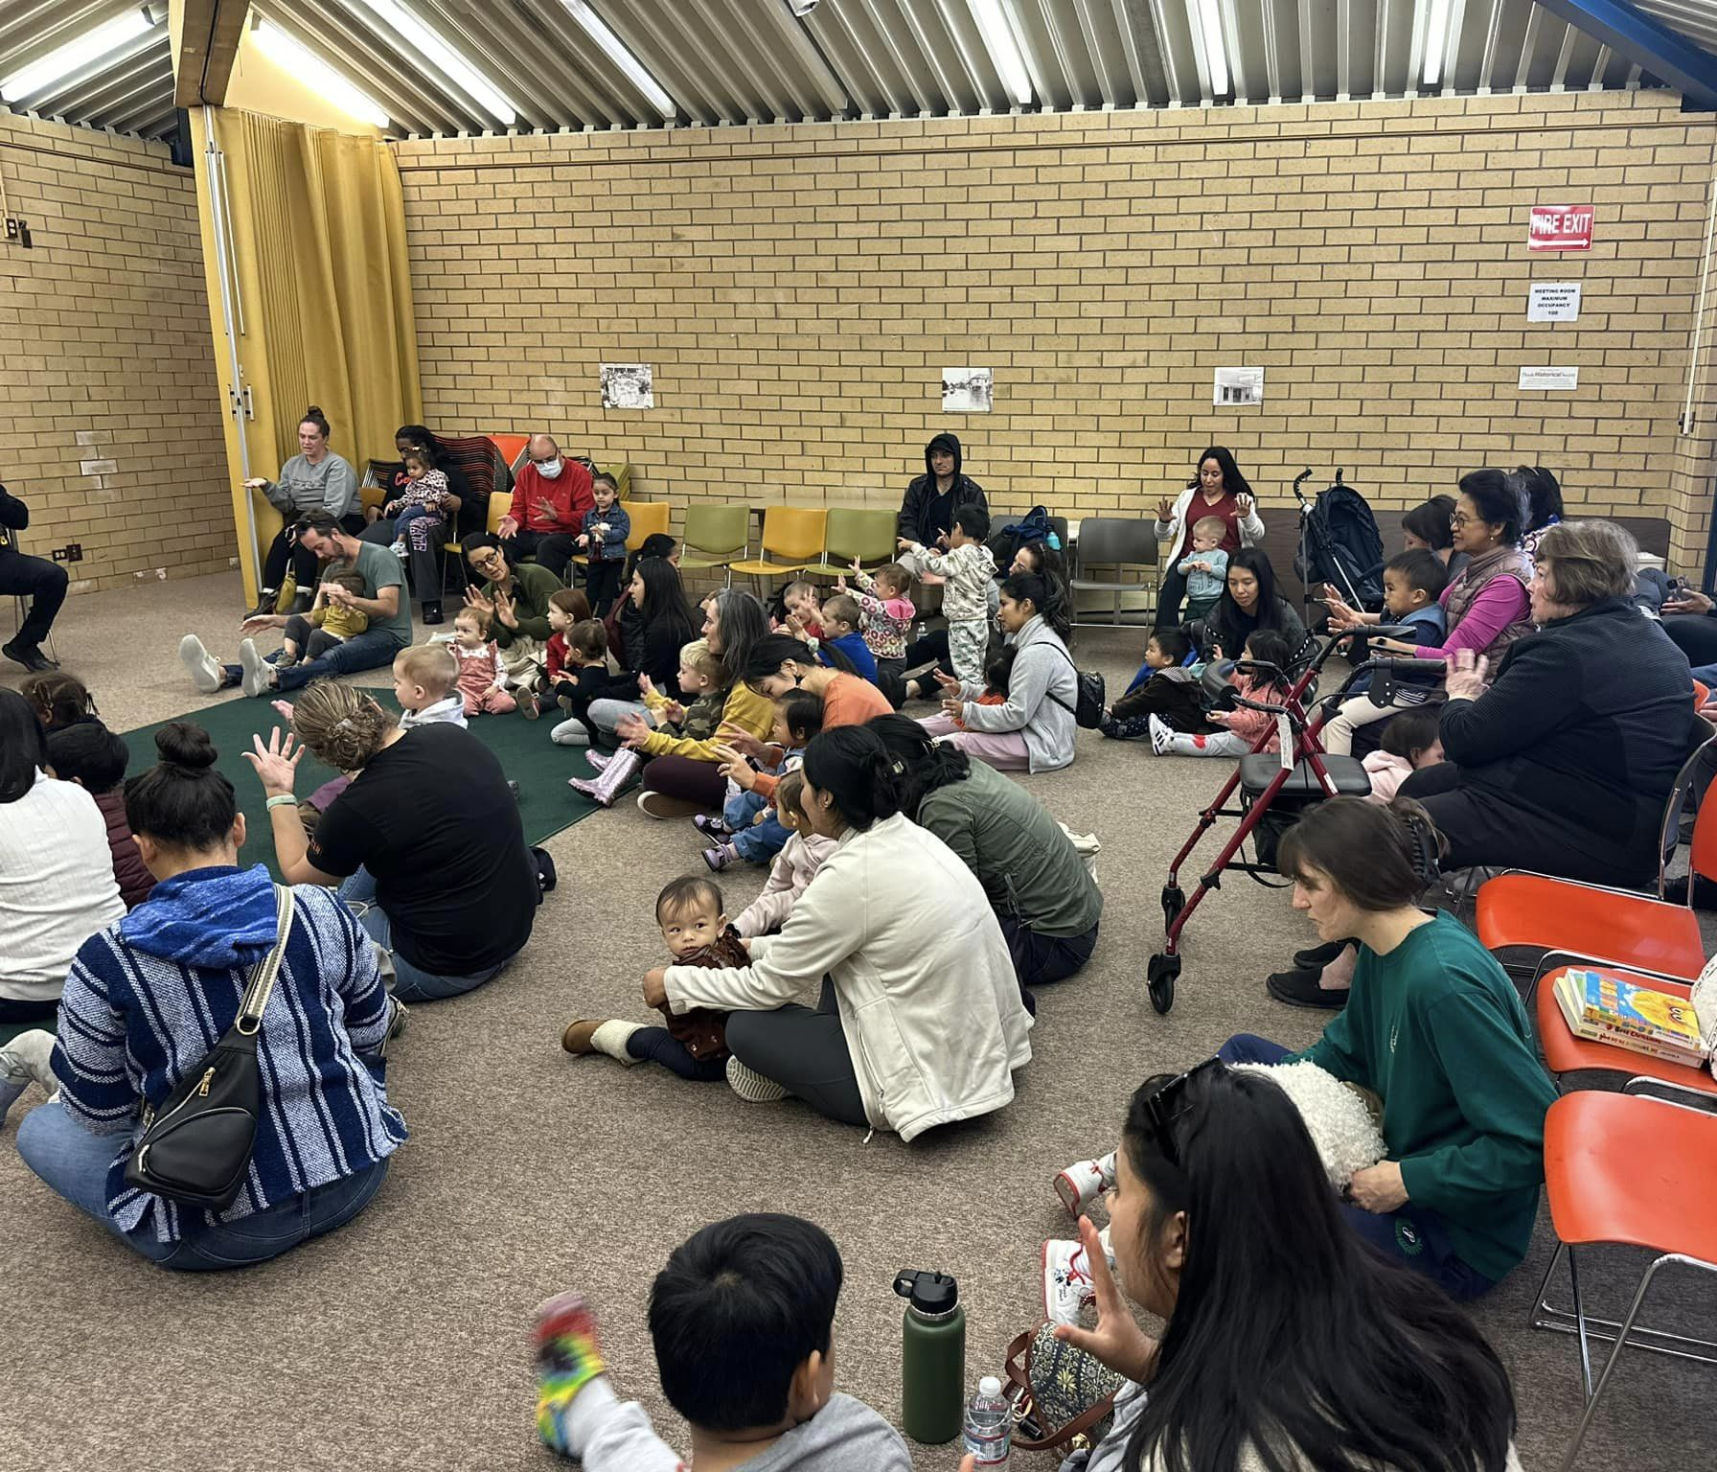
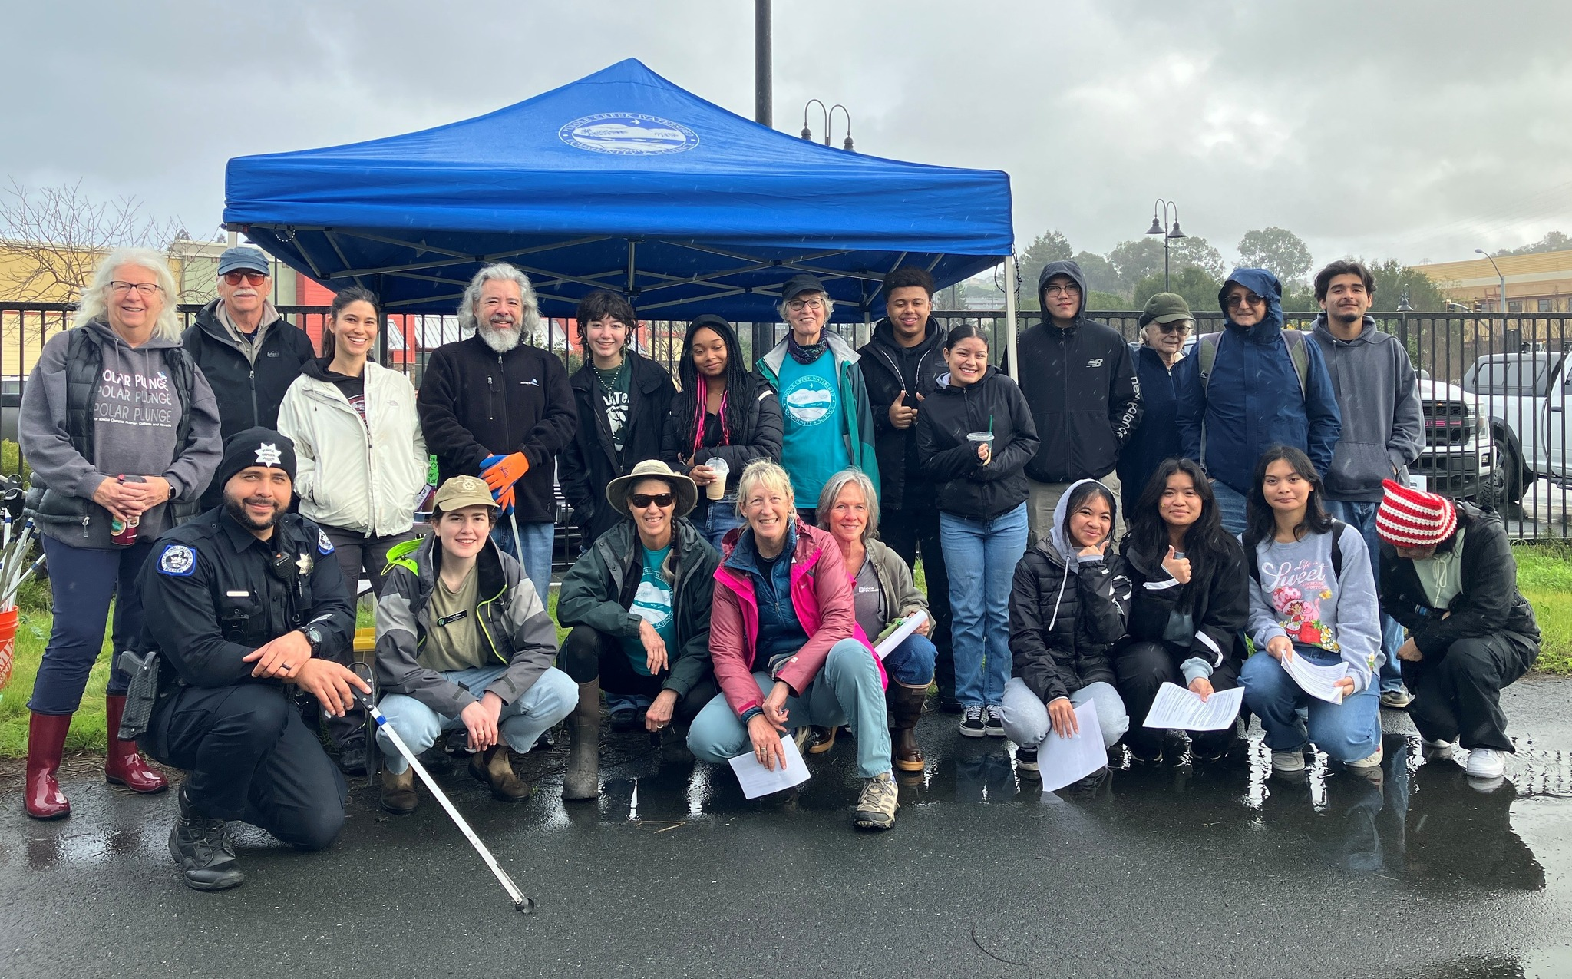
Community Engagement

Slide 20
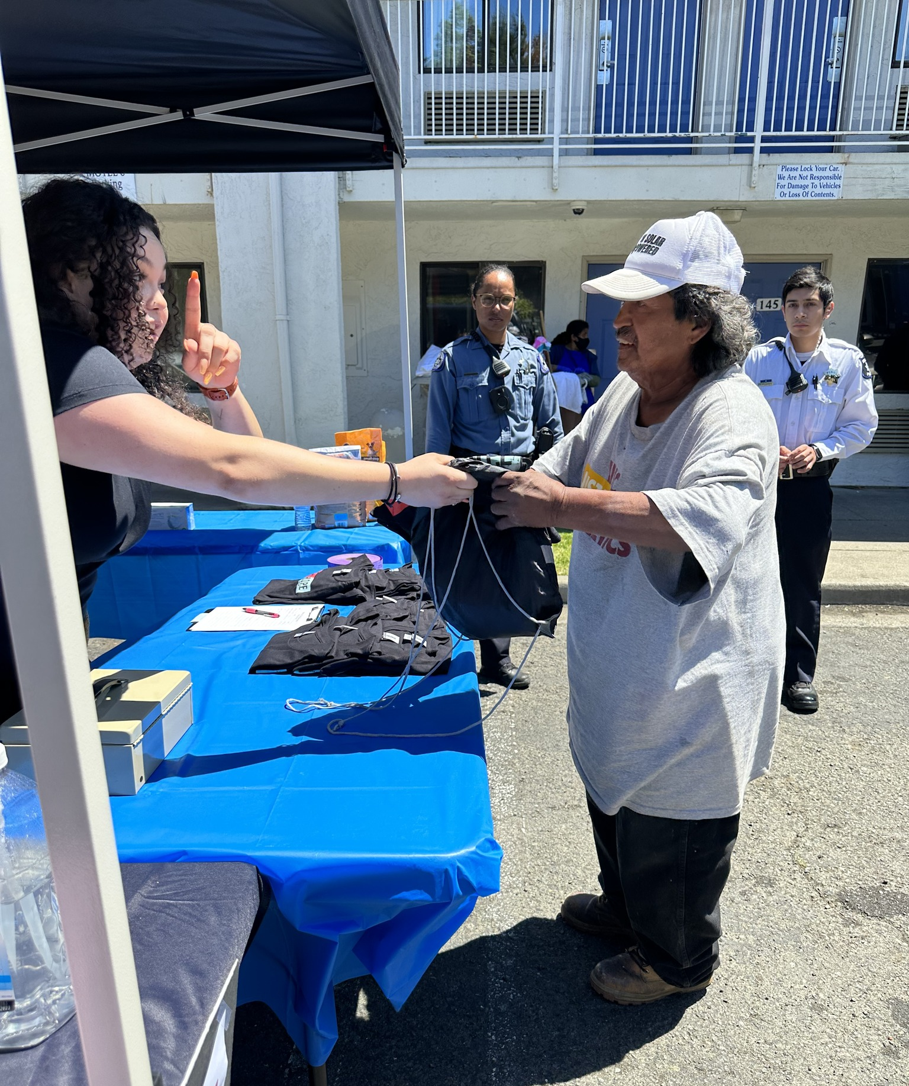
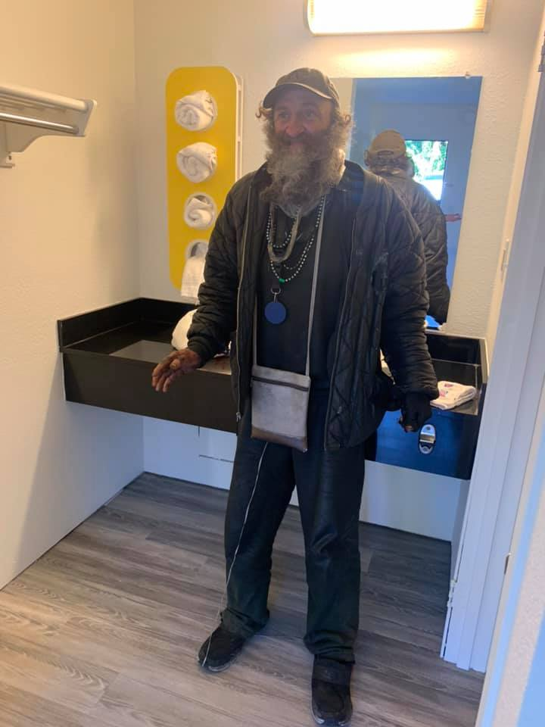
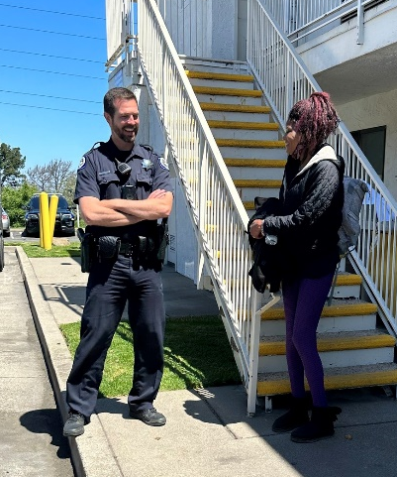
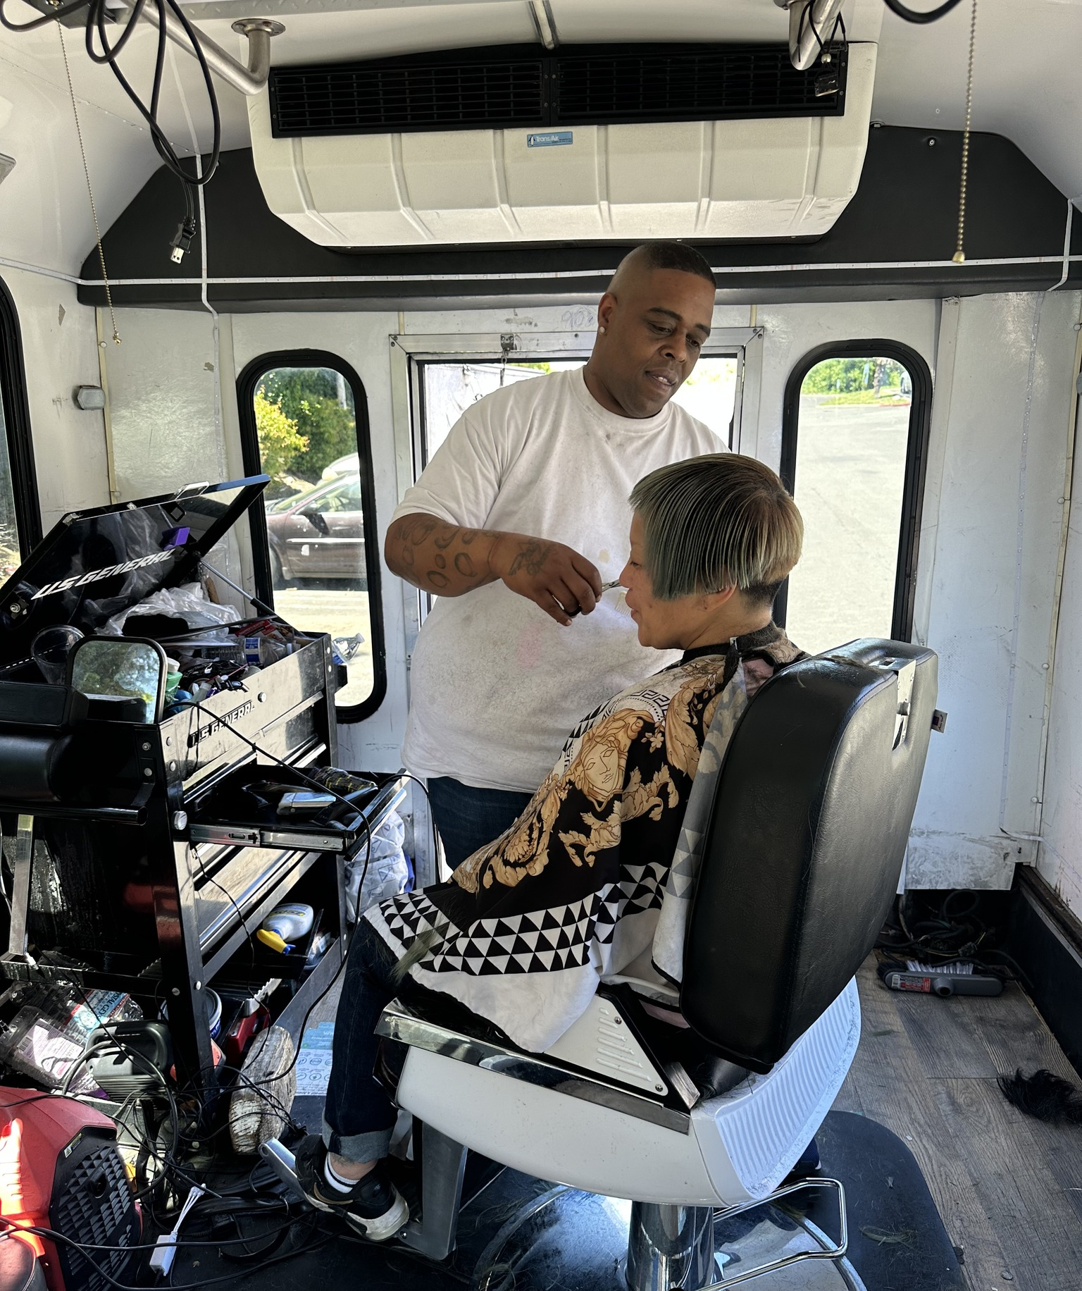

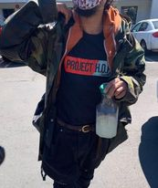
PROJECT HOPE
Helping
Others through
Positive
Encounters

Slide 21


School Liaison Officer Program & Student of the Month
Officers assigned to schools in their Beats to build relationships during non-police encounter environments

Slide 22


Operation Blue Angel
Those who are 55 years of age or older and live alone or
Alone for extended periods of time on a regular basis; or
People with a medical condition(s) that could lead to incapacitation and who live alone

Slide 23


Therapy Dog Program
Created Therapy Dog Program- 1st in the Bay Area
    Community Violence Solutions
    Early Child Development
    Children’s Interview Center
    Assisted Agencies Nationwide
    Milo Coloring Book

Slide 24
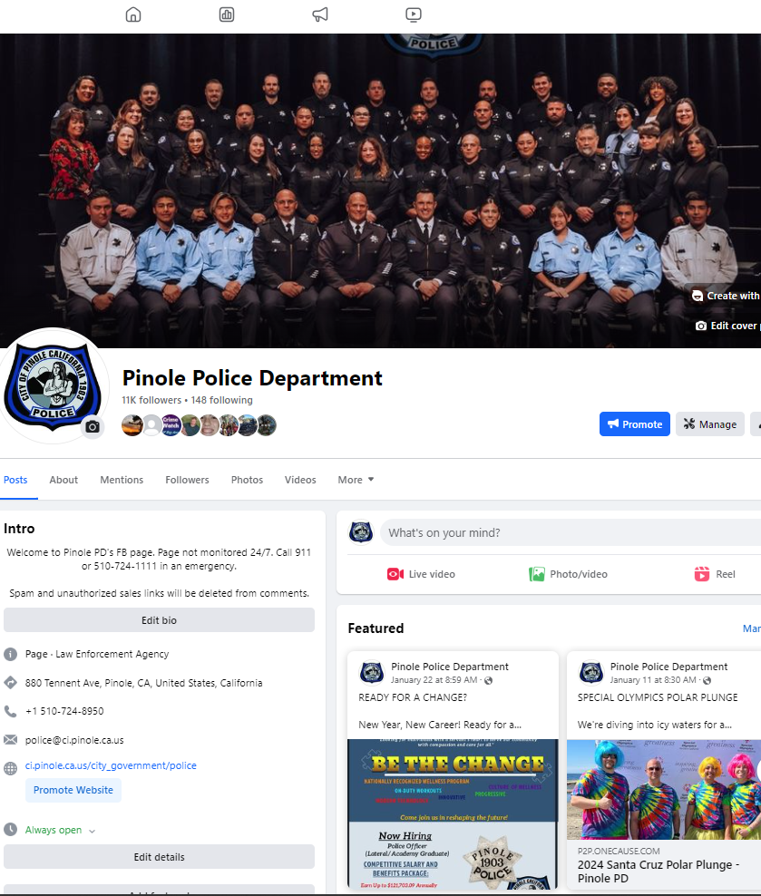
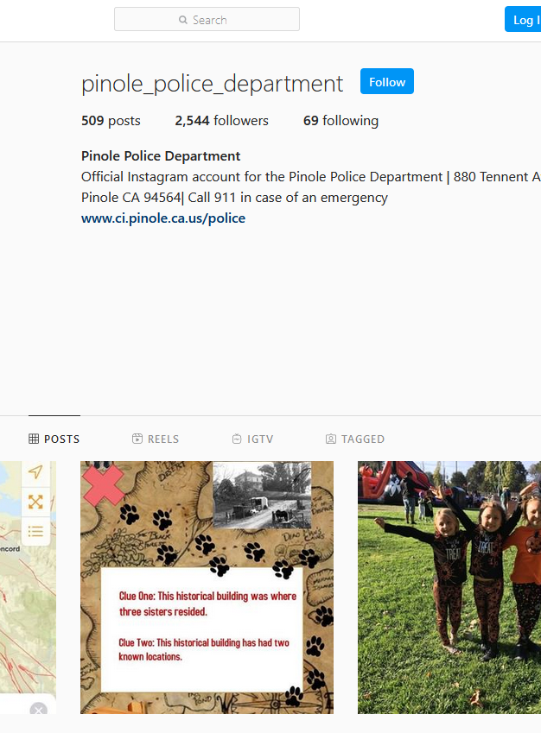
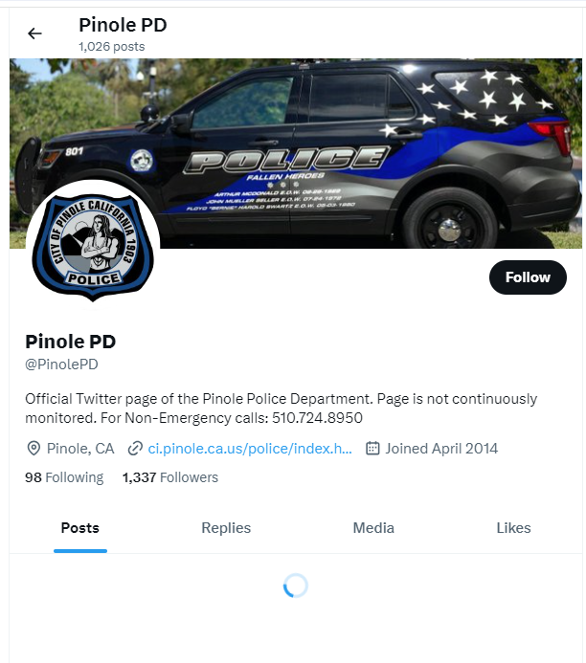



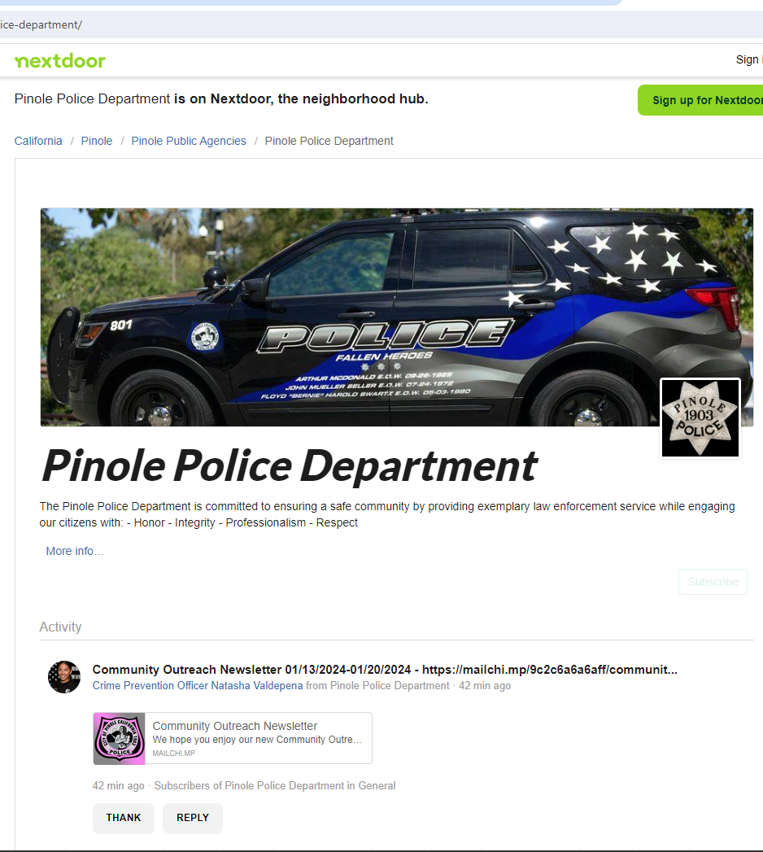

Social Media Platforms

Slide 25
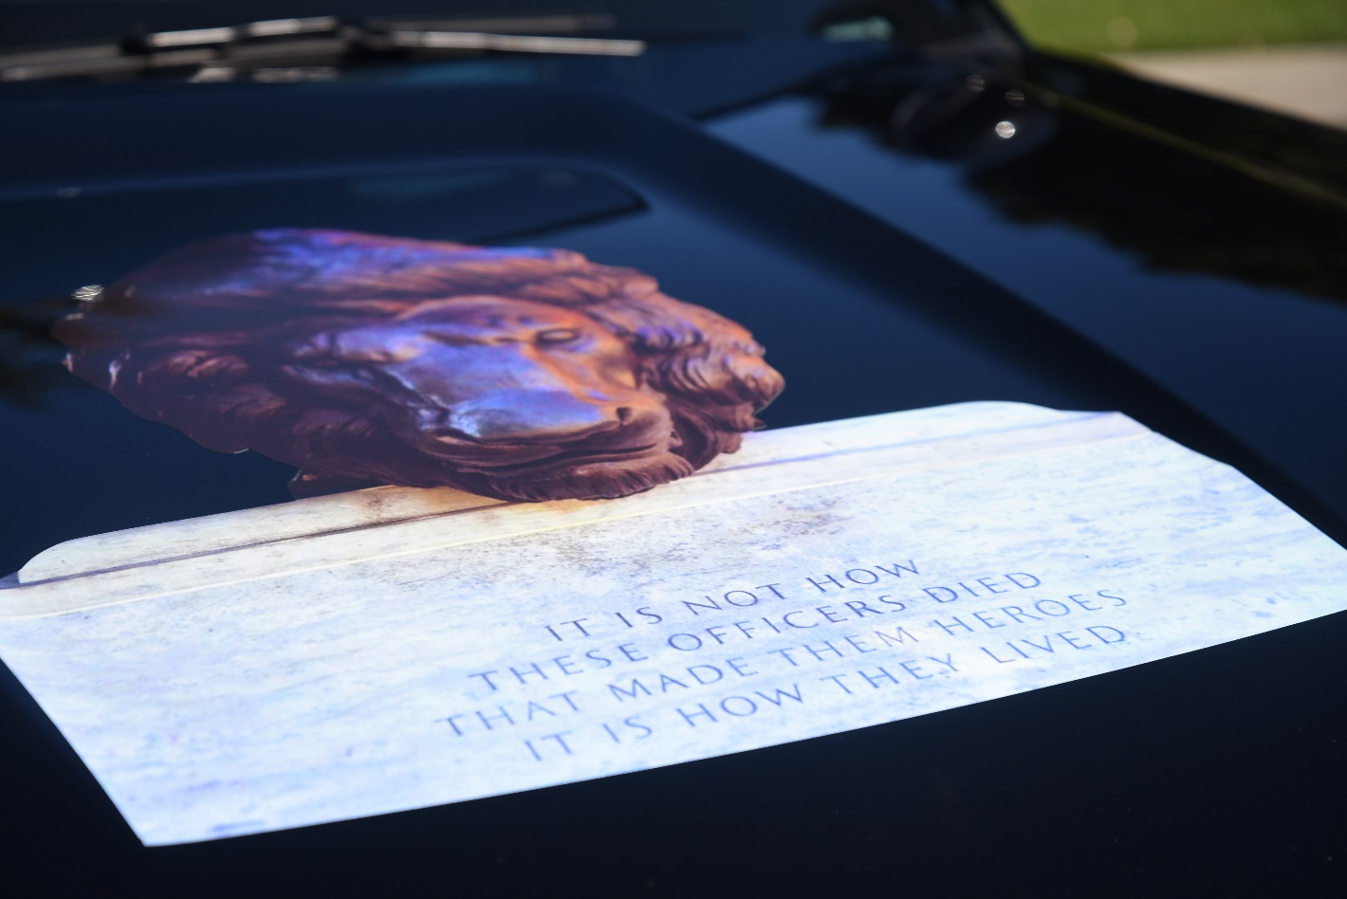
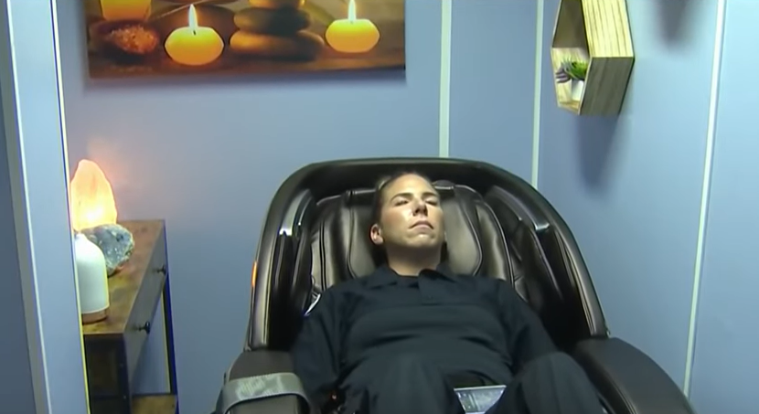
PPD IMPACTS ON THE PROFESSION

Slide 26
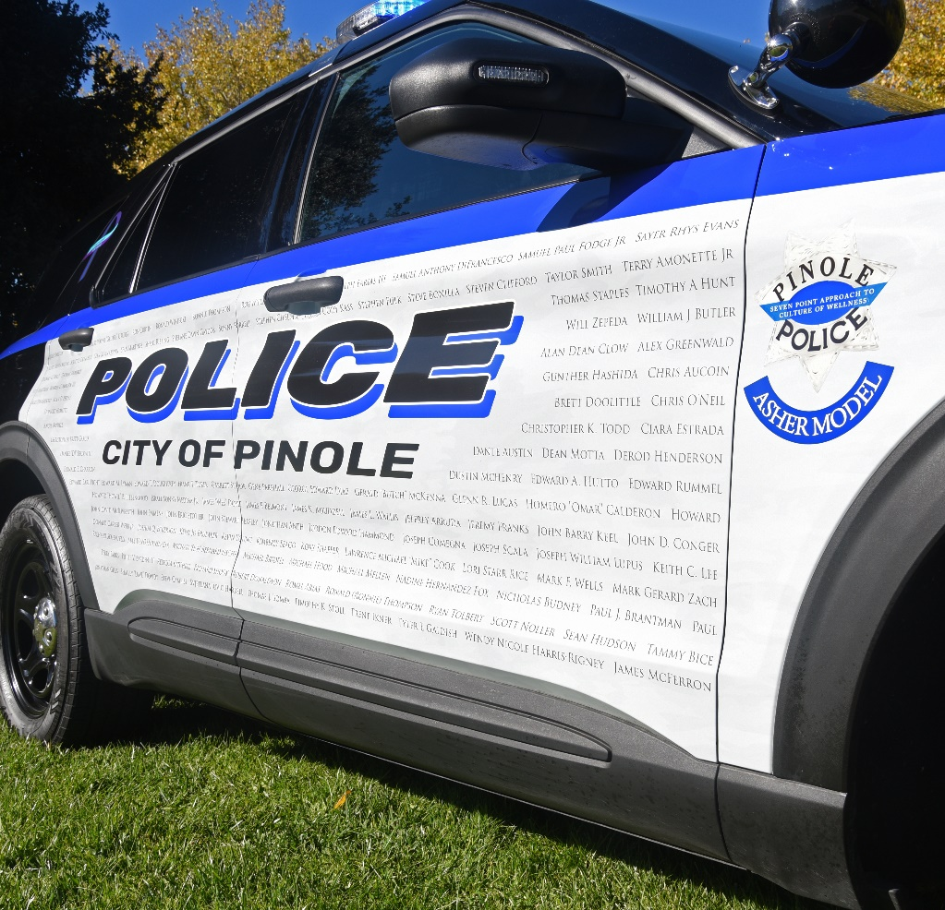
Smash the Stigma (STS) Vehicle #188
Created to raise awareness of our brothers and sisters in Law Enforcement who were lost to suicide and to recognize the mental health challenges faced by Law Enforcement professionals

Slide 27
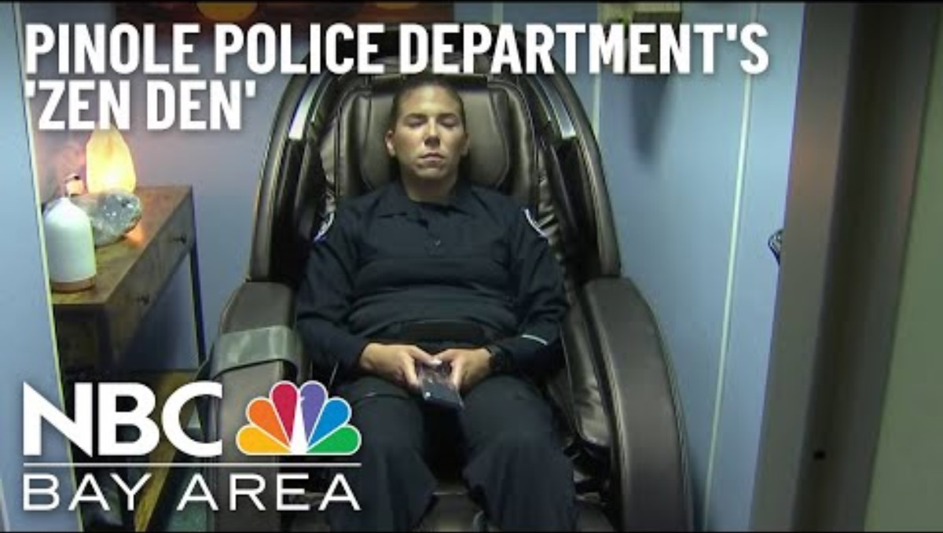

Slide 28
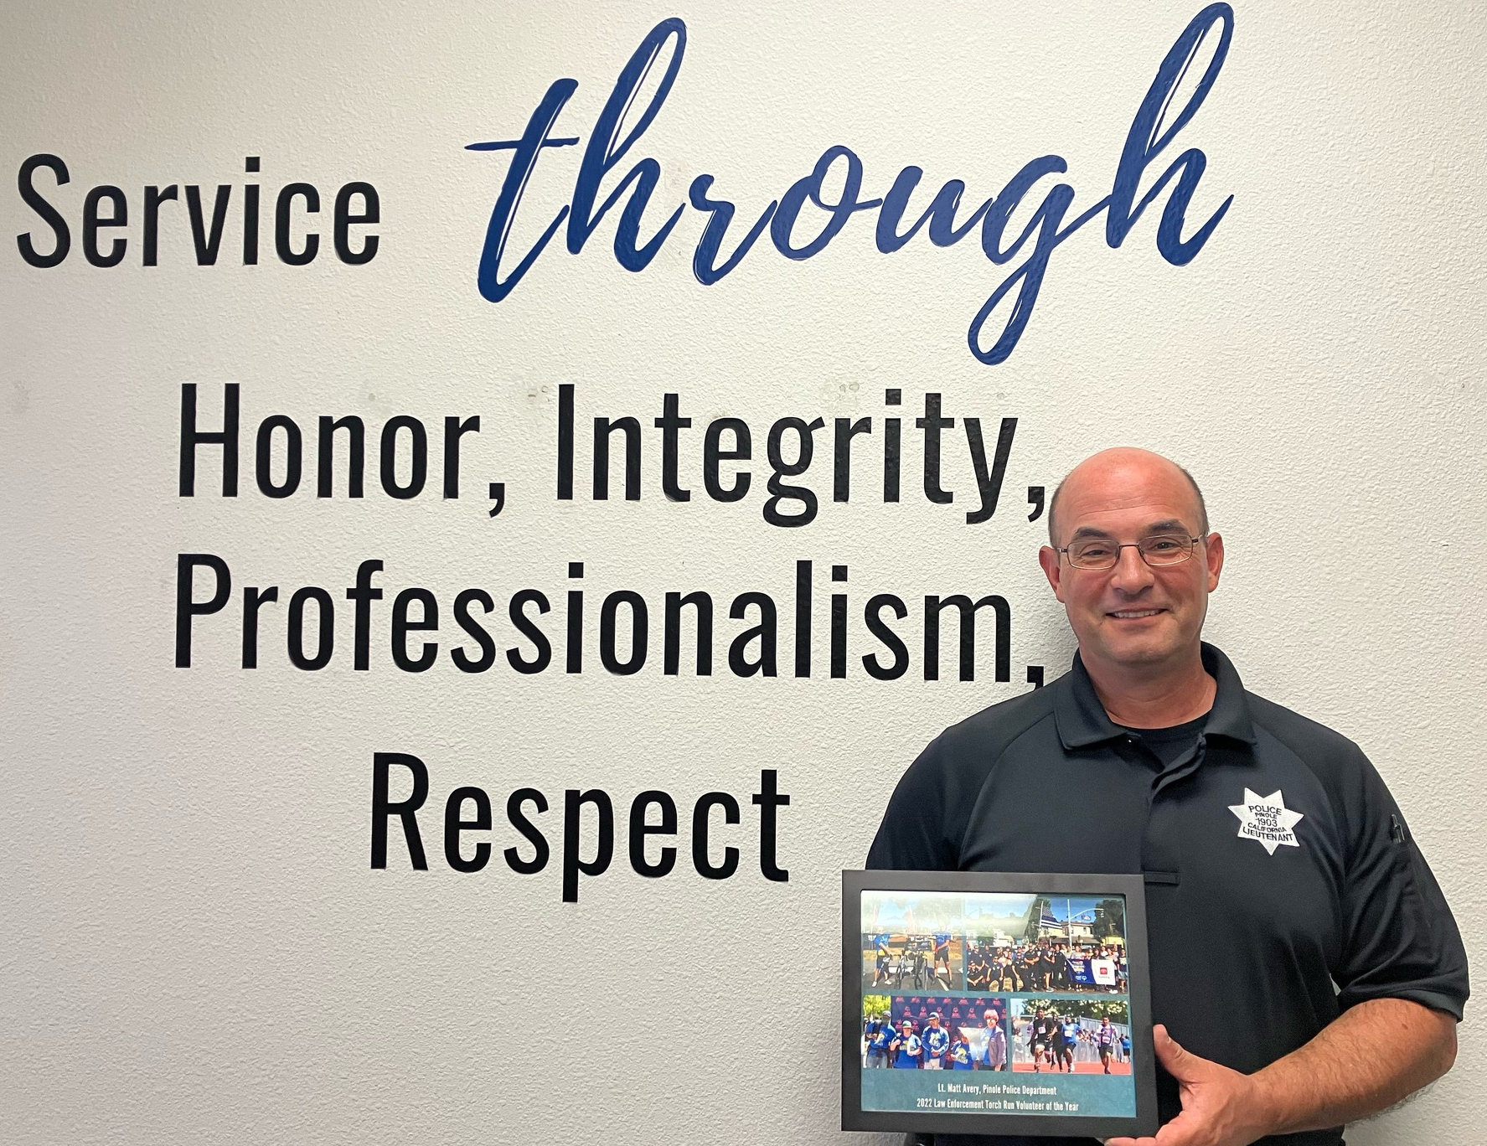
Bike the Bridges Ride Director & Special Olympics Northern California Volunteer of the Year!
Money Raised:
2022: $167,000
2023: $187,000 for Special Olympics Northern California

Slide 29
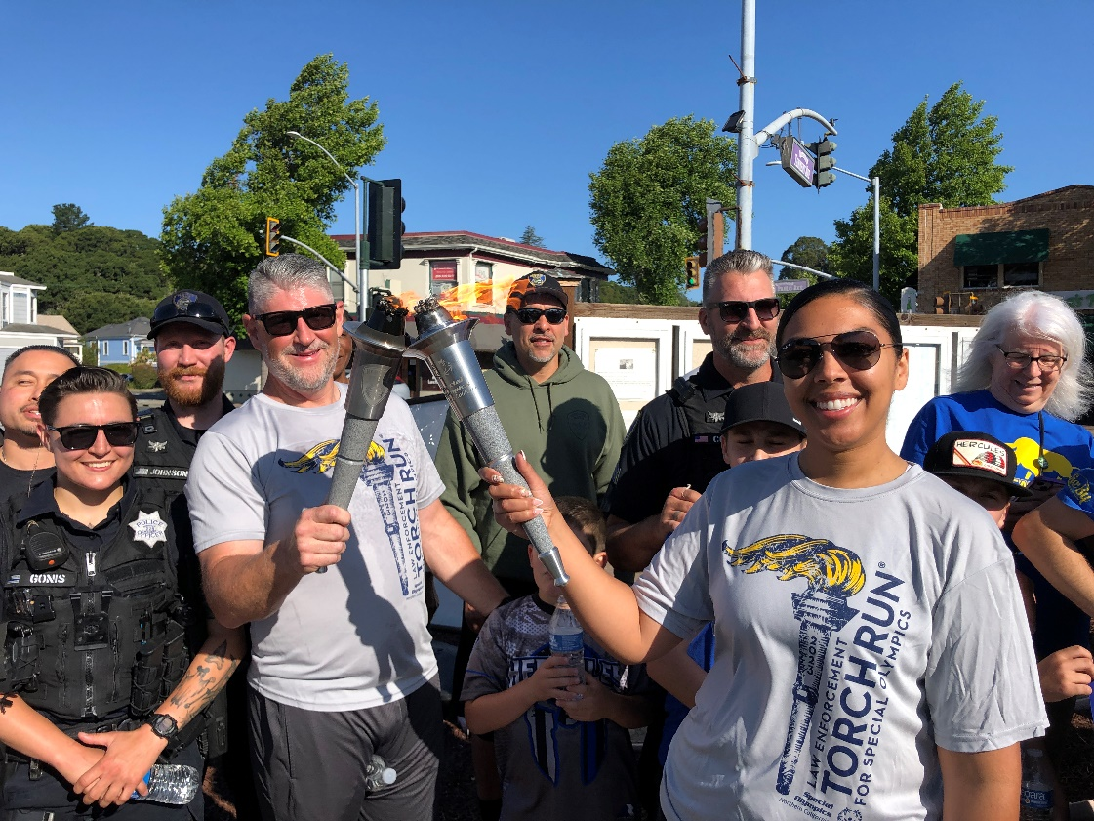
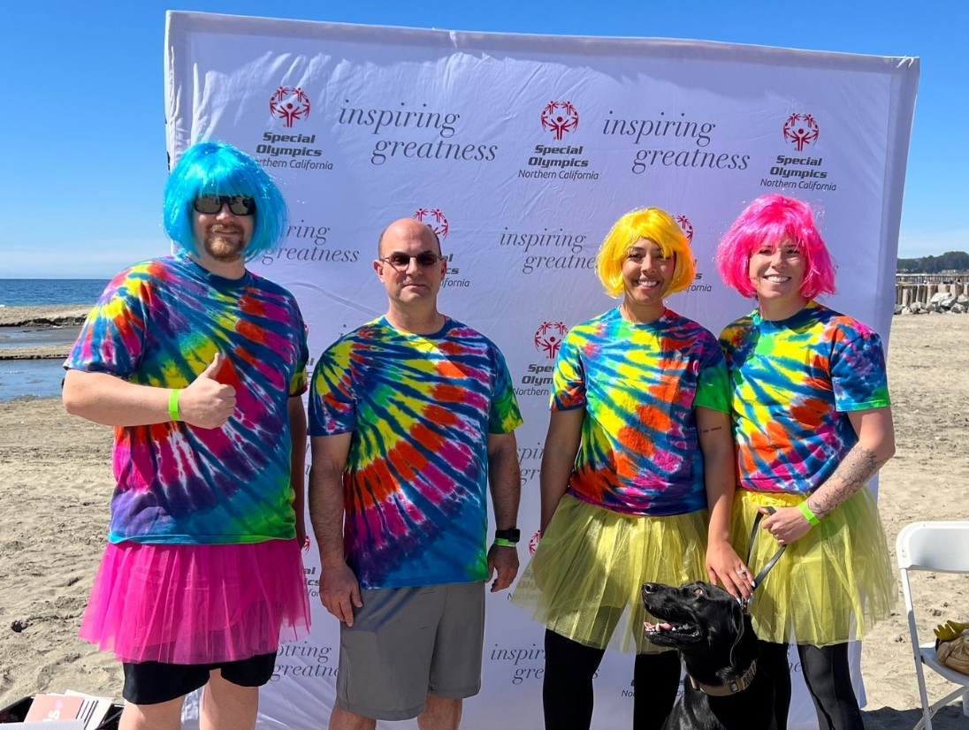
2023 Torch Run
& Polar Plunge

Slide 30
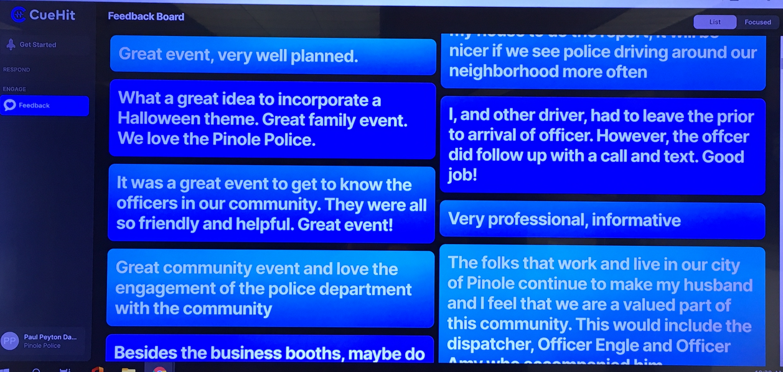

Emerging Technology & Training
PowerEngage (CueHit)
  Real-time community feedback
RIMS CAD RMS
  Collaborative and integrated dispatch and records management
  Real-time response mapping
PoliceOne Academy & LEXIPOL DTBs
  CA POST Complaint
  Multi-media solution-based training
  Customizable to community and department needs
  Risk mitigation through monthly policy review

Slide 31

Pinole Police
Department’s
PowerEngage (CueHit)

Slide 32
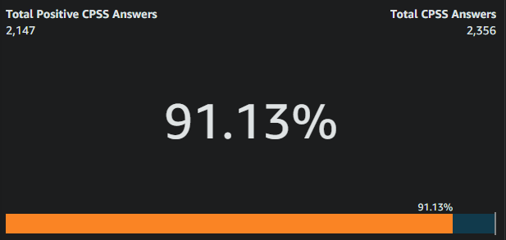
Pinole Police
Department’s
PowerEngage (CueHit)
Department Satisfaction Rate
(since inception July 2021 – Dec 2023)

Slide 33

AB2773: Requires a peace officer making a traffic or pedestrian stop, to state the reason for the stop, unless the officer reasonably believes that withholding the reason for the stop is necessary to protect life or property from imminent threat.

Slide 34


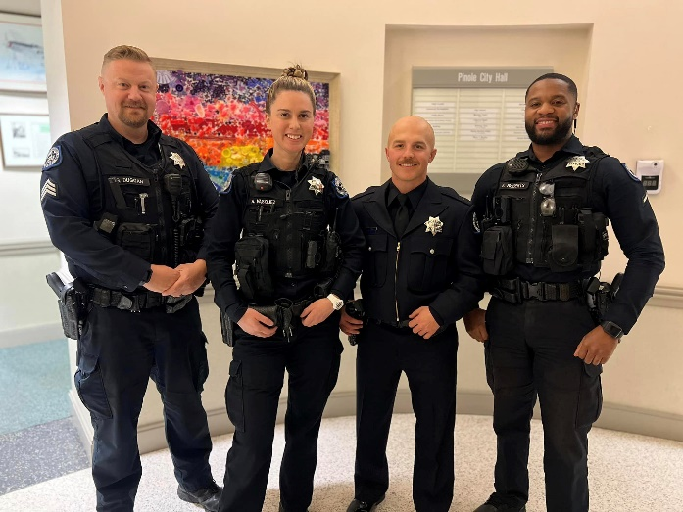

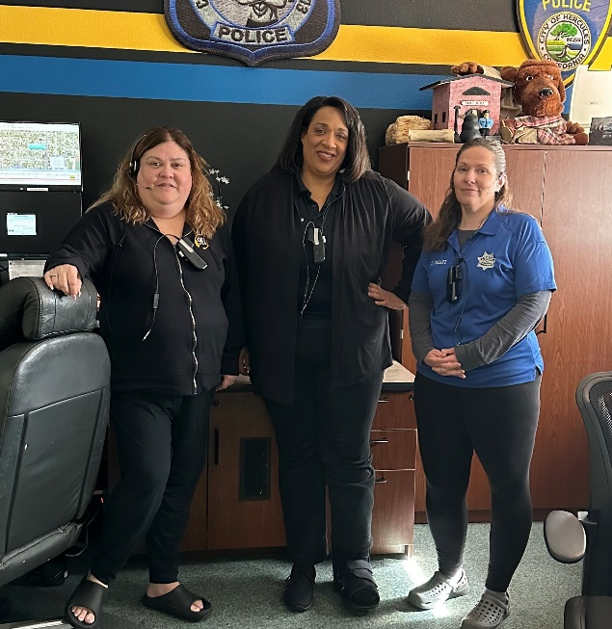
Organizational Wellness Initiatives

Slide 35
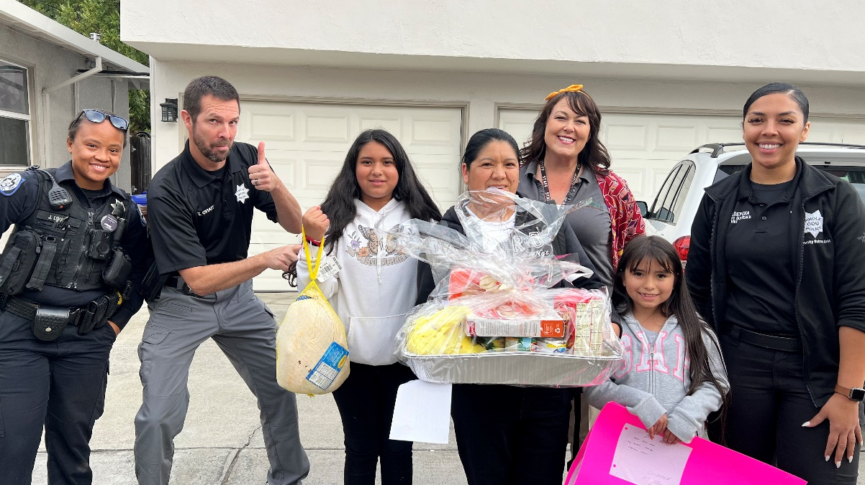
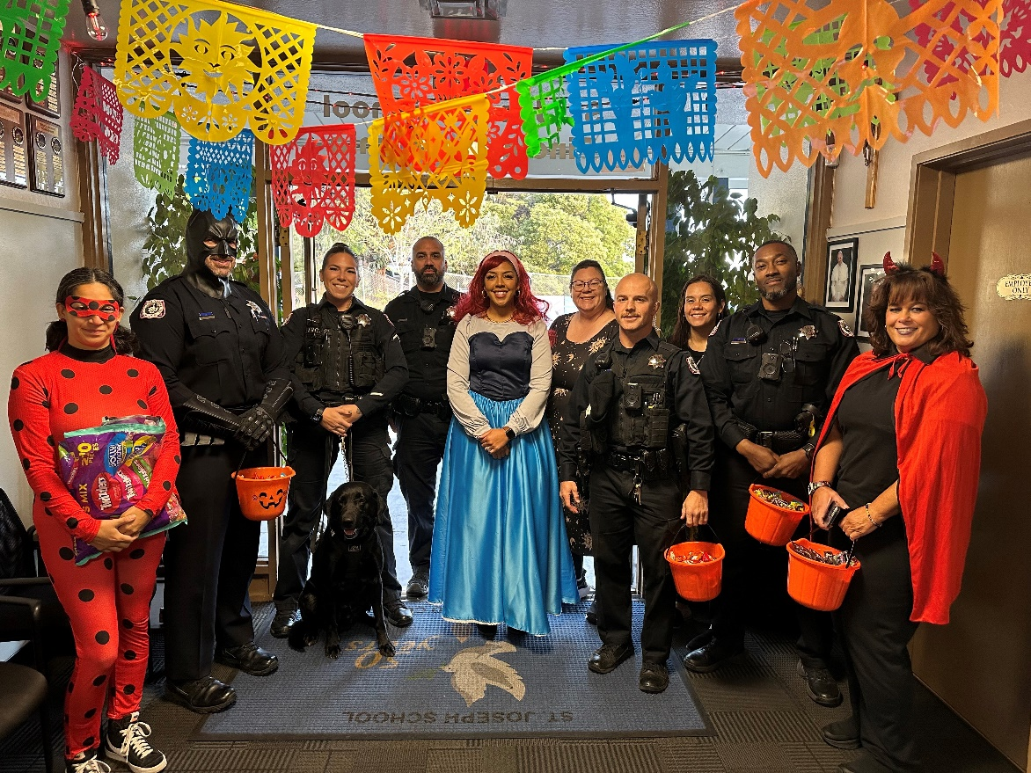
QUESTIONS?

